Slide 1
Olympics
Intan Dea Yutami

Slide 2
Agenda
Introduction
Questions and Hypothesis
Insights
New Metrics
Summary and Recommendation

Slide 3
Introduction

Slide 4
Introduction
This project aims to explore what kind of aspects than have contribution to maximize the number of medals achieved by a country in Olympic Games. To compete in Olympic Games, there are certain rules that must be complied to. One of the rule is the representation of each continent in the sport competition. It is also . It is also interesting to know whether some physical aspects have any role on the performances of athletes.
This project can be insightful for coaches or committee of national sports team to evaluate the performances of athletes sent to Olympic Games, or to decide which athletes to be sent.

Slide 5
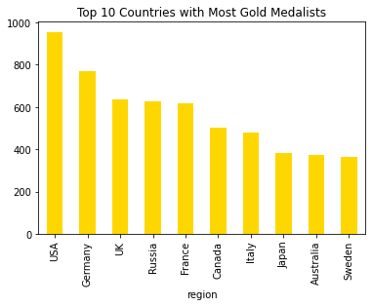
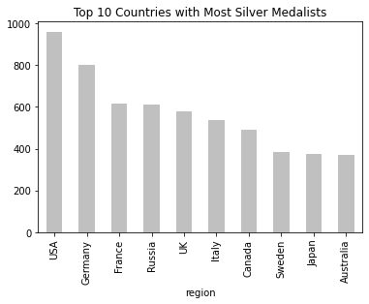
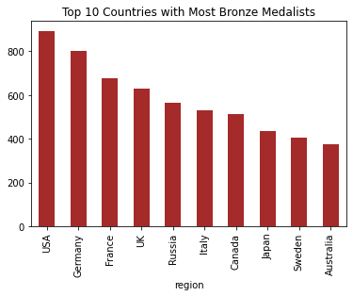
Top 10 Countries with Most…
Gold Medalists
Silver Medalists
Bronze Medalists
Based on those charts above, USA and Germany are two countries with the most medallists for any type of medal. Most of the top 10 countries here are from Europe.

Slide 6
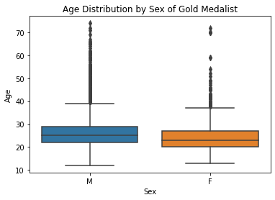
More Details on Gold Medalists
Based on age and gender, there is a slight different condition among gold medallists. According to the chart on the left, female athletes won gold medals in younger age than male athletes.

Slide 7
Questions and Hypothesis

Slide 8
Questions
What sport has contributed the most medals to certain country?
Does participating in Olympic Games for many times affect on the probability of getting medal in the next Olympic Games (OG) for an athlete?
Is There Any Significant Difference Between The Age of Medalists and Non-Medalist?

Slide 9
Hypotheses
Most contributing sport to medal achievements will be varied among the countries, depending on the strength of the country in respective sports
There is some correlation between current and previous achievements for one specific athlete in Olympic Games.
There is no significant difference is the mean/average age of medalist vs non-medalist

Slide 10
Insights & Further Exploration

Slide 11
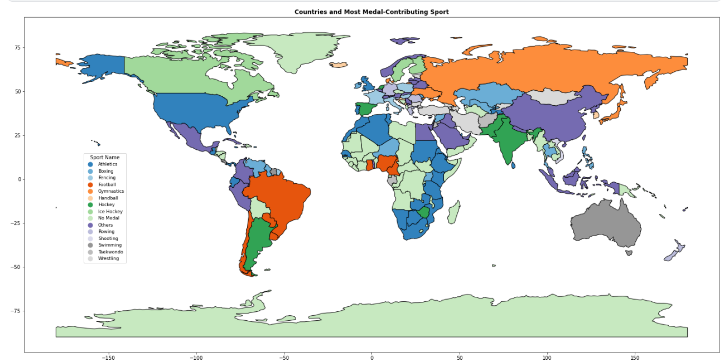
The Most Medal-Contribution Sports per Country

Slide 12
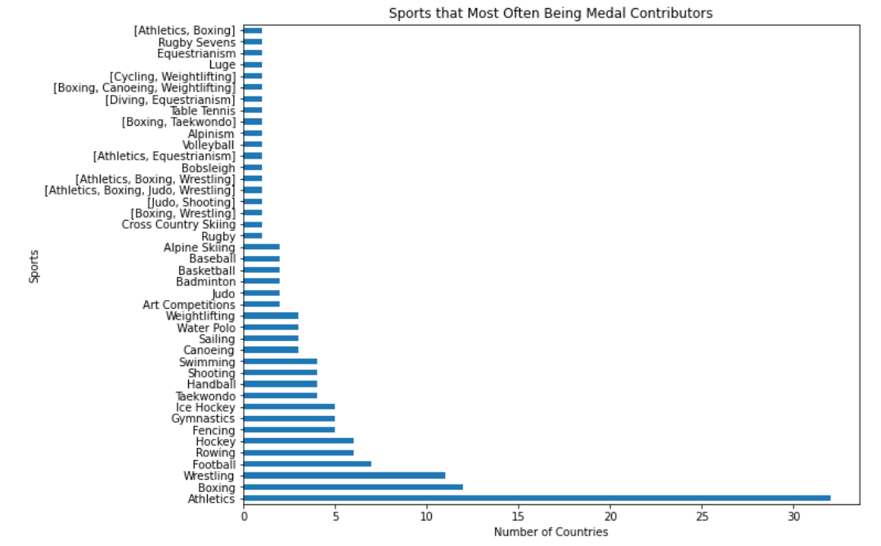
Sports That Most Often Being The Medal Contributors
Athletics is the sport we most often found as most medal contributor to a country.
Concluding the previous map, top medal-contributor sport does depend or vary to the country.

Slide 13
Does Having a Medal Before Have an Association with Performance in Current Olympic Games?
To measure whether such association is statistically supported, we must tabulate the number of athletes that gain a medal in an Olympic Games or not vs. having a medal in any previous Olympic Games or not.
 | Previously Got Medal |  | Total
Currently Got Medal | No | Yes
No | 216,584 | 14,749 | 231,333
Yes | 31,308 | 8,475 | 39,783
Total | 247,892 | 23,224 | 271,116
According to the Chi-Square Test for these two variables, there is enough evidence that there is any relationship between achievement of athletes in Olympic Games and their previous results.

Slide 14
Age Difference of Medalist vs Non-Medalist
To measure whether such difference is statistically significant, a statistical test must be performed (z-test).
According to the result, it is evident that by being older for half a year has a significant effect on receiving medal in Olympic Games.

Slide 15
New Metrics on Women Achievement in Olympic Games

Slide 16
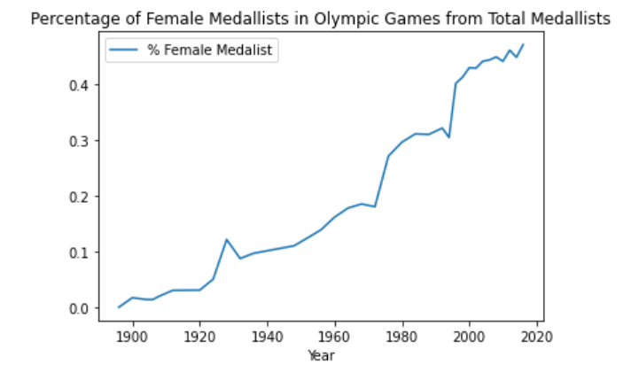
How Many Female Athletes Are Olympic Medalists?
In general, want to measure the diversity and success rate of female athletes in Olympic Games.
Total female medalists/total medalists for each year
In general, the trend is increasing, meaning more success trend and diversity towards women.
For each type of medal, here are the female medalist ratios:
Gold: 0.25
Silver: 0.275
Bronze: 0.28

Slide 17
Summary & Recommendations

Slide 18
Summary
Performance on current Olympic Games has an association to previous performance in Olympic Games
Being older for half a year has a significant effect on receiving medal in Olympic Games
Women in average received gold medal in younger age than men
The portion of female among Olympic Medalists is increasing each year

Slide 19
Recommendations
Consider the performance on previous Olympic for team selection, but do not make it a rigid requirement
Consider spending more effort on scouting female athletes

Slide 20
Thank you

